Slide 2

FLIPFIT

Slide 3

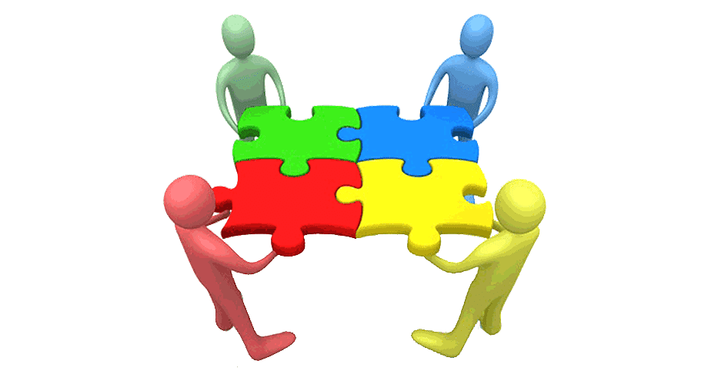
TEAM MEMBERS
ISHAAN
DHRUV
SAHIL
ANJALI
DIVYAM
MEENAKSHI
NIKHIL
AASHNA
PRANATI

Slide 4
FRAMEWORK FOR SIX DAYS
→ Make Daily Targets → Learn new Topics & Technologies
→ Resolve Doubts & Code Conflicts → Discussion with Mr. AMIT about Project Progress
&
Transformation based on UML AND Technologies

Slide 5

STAKEHOLDERS
SPONSORS
FLIPKART
SME
AMIT KUMAR BALYAN
TRAINING COORDINATORS:
SHARATH RAMESHA
&
BHAVYA S GOWDA

Slide 6

1
OUR JOURNEY ?
|_ UNDERSTANDING PROJECT GOALS
|_ DECIDE THE TECHNOLOGIES JAVA/REST
|_ DESIGN THINKING
|_ ADAPTING TO A DEVELOPER MINDSET
|_ PROJECT DEMO

Slide 7
OUR GYM MANAGEMENT SYSTEM WAS DEVELOPED USING JAVA, DROPWIZARD, AND MYSQL FOR THE BACKEND, WITH GIT AND GITHUB FOR VERSION CONTROL. API ROUTES, INCLUDING THOSE FOR PRODUCT MANAGEMENT, WERE IMPLEMENTED TO SUPPORT VARIOUS FUNCTIONALITIES.

Slide 8

AGENDA
Problem Statement
Project Goal
Engineering Practices
Tech Stack
Development
Demo
Challenges
Learnings

Slide 9

PROBLEM STATEMENT
Design a UI & Backend system for a Gym Management System for a new enterprise application that Flipkart is launching, FlipFit.

Slide 10

PROJECT GOALS
USER FRIENDLY BOOKING SYSTEM FOR GYM SLOTS
REAL TIME VISIBILITY OF GYM SLOTS IN SPECIFIC AREA
SEAMLESS SLOT CANCELLATION FEATURE FOR USERS
GYM OWNER REGISTRATION TO FACILITATE FACILITY SETUP
CUSTOMISATION OPTIONS FOR GYM OWNERS TO DEFINE SLOTS
&
SEAT CAPACITY EFFICIENTLY

Slide 11
ENGINEERING PRACTICES
MODULARISATION
CODE COMMENTS
PERFORMANCE OPTIMISATION
CODE REFACTORING
VERSION CONTROL
EXCEPTION HANDLING
DOCUMENTATION

Slide 12







TECH STACK & TOOLS

Slide 13
DEVELOPMENT
Developed UML Diagrams for improved Project Understanding
Created foundational java code structure with essentials files such as Beans, Client and business
Established connection with mysql database
Implemented REST API’s using drop wizard for efficient communication

Slide 14
CODE & UML DIAGRAMS

Slide 15
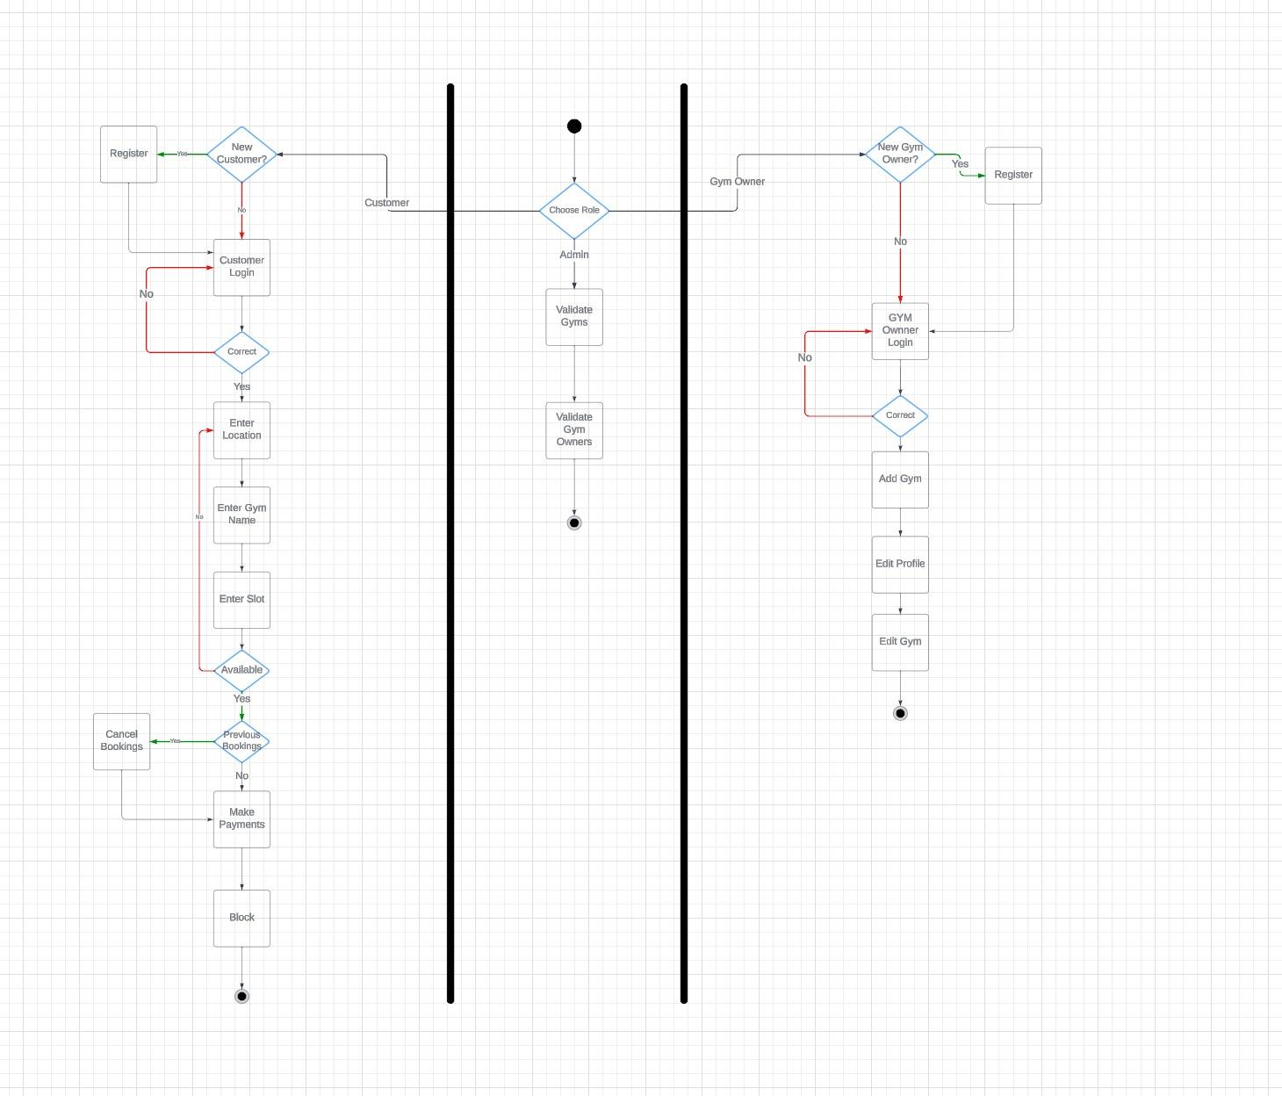
ACTIVITY
DIAGRAM

Slide 16
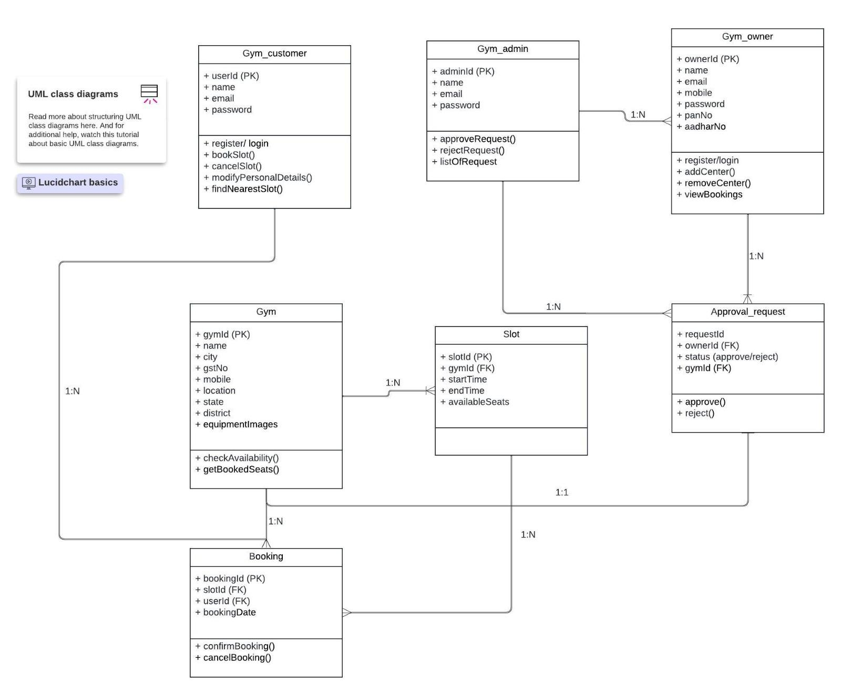
CLASS DIAGRAM

Slide 17
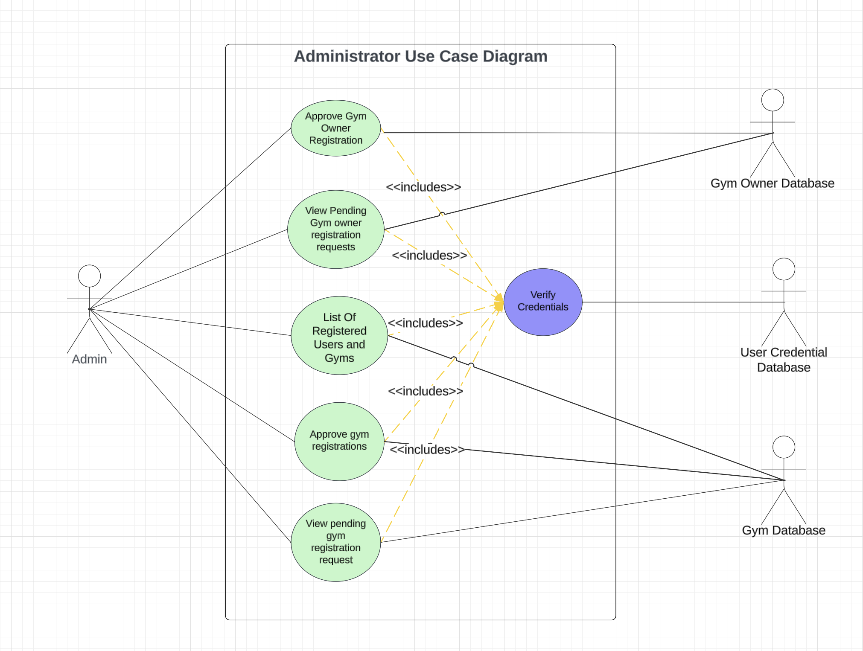
ADMIN USE
CASE DIAGRAM

Slide 18
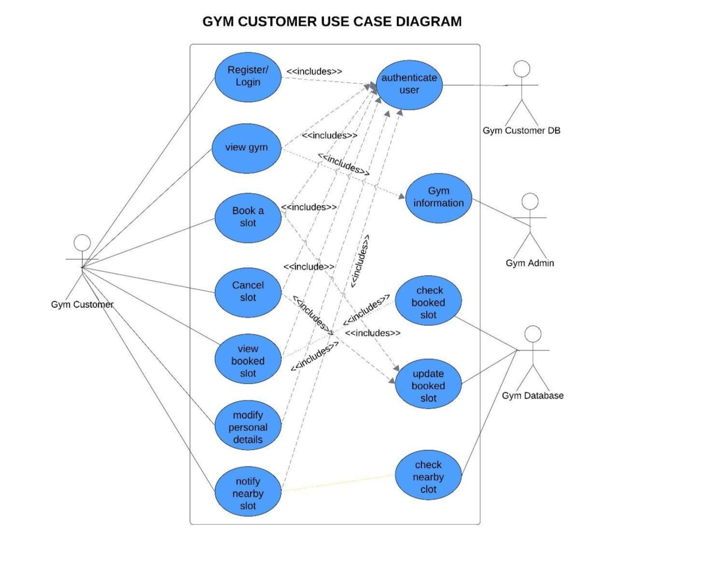
USER USE
CASE DIAGRAM

Slide 19
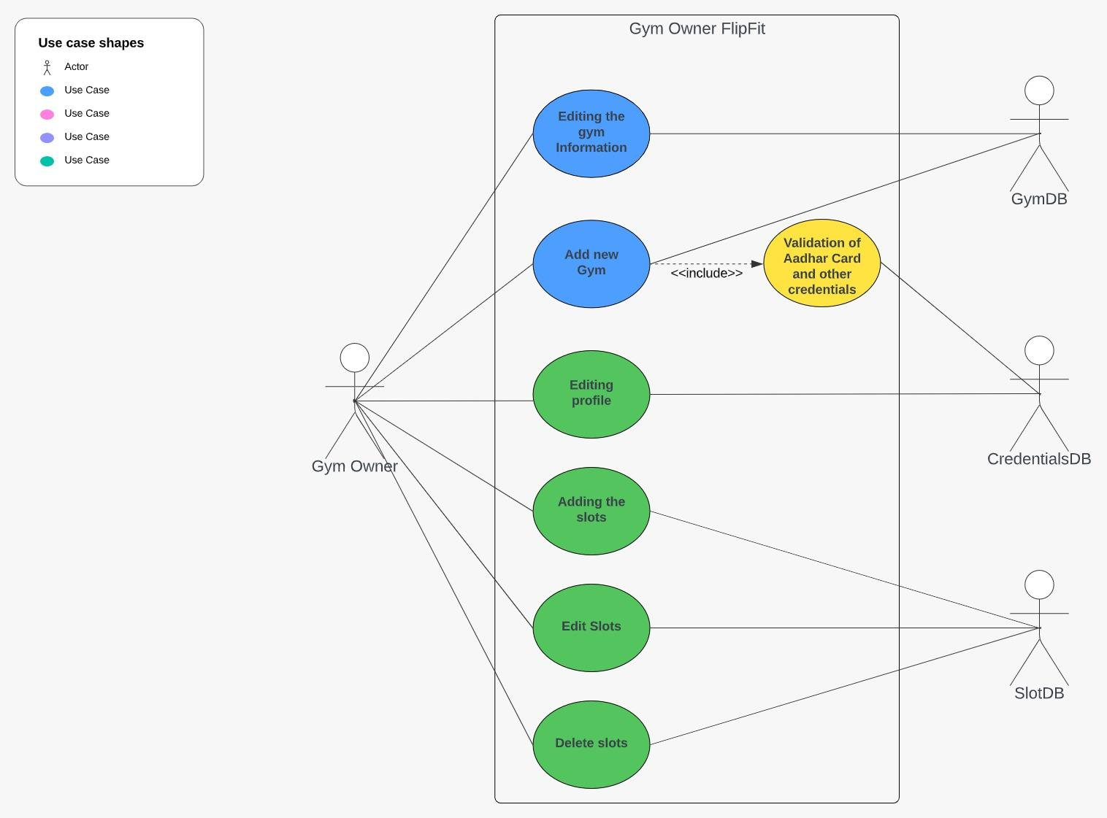
GYM OWNER USE CASE DIAGRAM

Slide 20
DEMO
Github Repository Link

Slide 21
CHALLENGES
TIGHT DEADLINES
TEAM COLLABORATION
UNEXPECTED BUGS AND ISSUES
TECHNOLOGY CHANGE
MERGE CONFLICTS

Slide 22
LEARNINGS
TECH STACKS
OWNERSHIP
TEAM WORK
TIME MANAGEMENT

Slide 23
THANK
YOU

